Slide 1

Business Retention and Expansion
Community Input, Celebration and Implementation

Slide 2
Implementation and Evaluation
Community Input/Resources Meeting
Community Commencement/Celebration
Quarterly Meetings (at least with Task Force on progress of efforts
Documentation/evaluation of Success in Implementation of individual efforts/tasks/strategies

Slide 3
Community Input/Resources
Purpose of Meeting:
  Avoid reinventing the wheel
  Avoid turf battles
  Maximize/leverage the effort of other groups
  Avoid the embarrassment of unknowingly duplicating efforts

Slide 4
Community Input/Resources
Invite agencies that might be working on your selected priorities
Ask them (ahead of time) to address:
  1) What are you doing on this project?
  2) If doing something, is it reaching local firms?
  3) If not, can we collaborate to reach more of our firms?

Slide 5
Community Input/Resources
Sometimes done with full task force
Sometimes done only with smaller workgroups.

Slide 6
Community Commencement
Celebrates end of planning phase and dedicated to moving aggressively into implementation
Invite everyone directly involved in the program including other local leaders, regional and national leaders
Aim for 100+ participants

Slide 7
Community Commencement Meeting
Program Topic | Person Responsible | Time
Introduction | Project Coordinator | 10 min
Program purpose/history | Task Force Leader | 5 min
Testimonials/accomplishments | Business Owner(s)/Project Coordinator | 10 min
Strategy 1 | Task Force Member A | 10 min
Strategy 2 | Task Force Member B | 10 min
Strategy 3 | Task Force Member C | 10 min
Congratulations | Project Coordinator | 5 min

Slide 8
Method of Presenting BR&E Strategies
5 to 10 minutes per strategy
For each one, provide:
  The overall concept of strategy
  Survey results related to the projects adopted
  Projects/tasks/strategies adopted by the Task Force

Slide 9
Invite Agency Staff to Community Commencement Meeting
Include regional and provincial/state staff in the invitation
They can learn about your priority projects.
Invite them to speak briefly about how they can help you with implementation (send them an advanced copy of summary so they are on target).
Invite them to follow-up meetings as well.
Encourage their participation in the implementation of the Task Force’s work
Notes:
Number 1 – always invite

Slide 10
Mail BREV Summary to Everyone
The number and type of firms visited (be sure to get the firms’ explicit permission before you publish their names)
The names and affiliations of the volunteer visitors
The members of the Task Force
Community Leaders- Elected, appointed, others
State/provincial legislators and their staffs
State/provincial development agencies
Extension Service/technical assistance providers

Slide 11
Plan Implementation
This type of program cannot be accomplished in nine (9) months; it typically takes 2-3 years at a minimum
Other groups will not implement projects developed by the BR&E Task Force if the Task Force itself is not actively involved
It’s okay for the small implementation groups to shift members
Hold quarterly meetings to monitor progress
Notes:
Remind the task force that this is not a nine month project…..implementation for many of the projects may take 2 years or more. The organization, collection of data, research, individual business follow-up and planning takes the nine months.
Each task force member should be involved in at least one of the projects.
Shows this group is responsible for action
Gets the group started on action plan
Ensures that someone calls second meeting before the commencement meeting….why is this important?
Work on implementation happens in small groups or committees (2 to 6 people) The chairs of the groups get together quarterly with the full task force to report progress or need for assistance.

Slide 12
New Leadership Team Members
If possible, replace only two of the four members of the Leadership team at one time in order to provide some continuity.
It’s okay for members to continue participating in the team if they are willing and able.
Notes:
It is highly recommended that you begin a transition of leadership team members if they so desire at the first quarterly meeting. Why is this important?

Slide 13
Distribute One Page Reports
This refers to keeping the members of the small implementation teams up-to-date with the progress of implementing the plan
Distribute early and often.
Mail with notices of quarterly meetings and distribute again at the meeting.
Notes:
Reports of what is happening within each small team should be distributed prior to each meeting for more effective meetings. Distribution lists should include all involved in the program plus decision makers and sponsors.

Slide 14
Evaluation of Implementation
To what degree do BR&E programs actually implement projects?
What factors are likely to influence the degree of implementation of the priorities set by the local Task Force?

Slide 15
Summary of “How Successful Are Business Retention and Expansion Implementation Efforts.” Economic Development Review, 1997
Data from 91 BREV programs in four states (Minnesota, Missouri, Nebraska, and Ohio)
Average program adopted five projects
What percent of the projects were implemented?

Slide 16
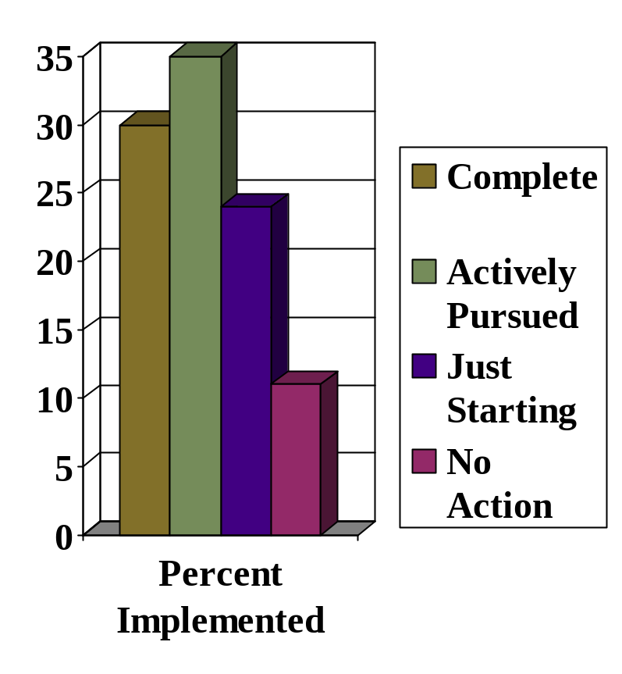
Status of Implementation Efforts
30% of projects were implemented
35% were being actively pursued
24% were just starting
11% had no action

Slide 17
Factors Increasing Degree of BR&E Project Implementation
Use proven strategic planning methods…plan for success!
List those responsible for implementation and progress in the reports
The Task Forces held meetings after the report was presented
Adequate budget (average at that time was $2,500)
There was a BR&E Professional (someone who was familiar with the program, familiar with the factors of success in a BR&E Visitation program and was a champion of the effort) who continued working on BR&E (average was 1.1 per program)
Time since completion of report

Slide 18
Programs in this study were done from 1991-1995
Additional research studies on success of implementation are located on the BREI website under the certified BREI Project Coordinators and Professionals section.
Notes:
We found through more recent studies that the results are the same. The factors that made earlier programs successful still apply today.

Slide 19
Keep Publicizing Your Program
Market
Market
Market
Market
Market
Market
And Market!

Slide 20
Questions?

Slide 21

Creative Commons License
This work carries an attribution non-commercial share alike license.
http://creativecommons.org/licenses/by-nc-sa/3.0/
Notes:
Trained and certified instructors by BREI or the Cooperative Extension System are allowed to remix, tweak, and build upon this work non-commercially, as long as they credit the original authors and they must license their new creations under the identical terms. This work can be downloaded and redistributed, but all new work based on this work must carry the same license, so any derivatives will also be non-commercial in nature.

