Slide 1

Roles of Leaders
Local Leaders are the Key to a
Successful BR&E Visitation Program

Slide 2
Success Factors
Pounding the Pavement by Karen Dickson
Notes:
What made this a successful program…what were the key factors?

Slide 3
Local Leaders in BR&E Visitation Programs
Leader Component | Number
Task Force | 10-20+ persons
Leadership Team | 4 or 5 persons
Visitors (more is a plus) | 15-30 persons
Firms Visited | 30-100 firms
BREI Project Coordinator | 1 person
State/ Provincial Staff | 2-3 persons

Slide 4
Task Force Membership
10 & 30 + people
Four major groups of people
  Local development professionals
  Business owners/operators
  Local government officials
  Educators (K-12 plus higher education)
  Others????

Slide 5
Who Should be on the Task Force?
Recognized and respected community leaders
Why? Only power of the group comes from the information collected, research done and the reputation of the Task Force
Ability to work easily with others

Slide 6
Task Force’s Role
Set overall policy of local BR&E Visitation Program
Recruit volunteers (1 or 2 persons)
Attend training and visiting 2 firms
Go to two “red & yellow flag” meetings
Review research results and set priorities
Assist in the implementation of projects
Attend quarterly meetings after priorities are set

Slide 7
Leadership Team
Visitation Director – organizes the firm visits
Business Resources leader (aka the “Red Flag leader”) – organizes the red flag follow-up
Media Relations – promotes the program
Milestone Meeting Facilitator – organizes the community meetings
Overall Coordinator/Champion – chair of team (one of the above)

Slide 8
Benefits of Serving on the
Leadership Team
High visibility of successful programs
Identification of major issues
Improved efficiency in contacting firms
Opportunity to learn more about local economy and firms
Chance to understand local leadership
Improved business retention and expansion

Slide 9
Volunteer Visitors
Potential Volunteers
Business people
Economic Development Professionals
Chamber of Commerce
Ministers
School Officials
Service Agencies
Utility Representatives
Bankers
Should be aware and enthusiastic about the program
Represent a cross-section of professionals and organizations
Should be influential and know the community
Should be able to maintain confidentiality

Slide 10
Volunteer Visitors
Visit 2 to 4 firms
Takes about 6 to 10 hours
Selected by the Task Force members
Community leaders

Slide 11
Benefits to Volunteers and Communities
fun
builds networks
a learning experience
brings the community together
do-able, and it gets results
demonstrates that we care about business
low risk, but only if done correctly

Slide 12
Firms
30 to 100 firms
Structured survey
Two practice firms
Notes:
Firms can be solely manufacturing, mixed sector, retail, service or any combination. Would highly recommend that you do all of your primary sector businesses as they contribute new dollars to the economy and so have the greatest impact.
The reason that 30 to 100 business is suggested is that you can do that many in a very short time frame to provide that snapshot in time to look at the health of the business sector or environment as a whole.
Survey design is a separate section in this course but it is necessary for the aggregation of data that the same survey is used with all businesses. Sections can be skipped if not appropriate in a mixed sector survey.
Two practice visits are conducted prior to the firm visitor training to test the instrument and to train the leadership team.

Slide 13
Project Coordinator’s Role
Coach to local leaders
Assists the group to decide on whether or not the BR&E Visitation program is for them
Assists the group to determine whether or not they are ready (Tab 7 – 13 questions)
Makes between 8 to 12 trips over two years

Slide 14
Meetings 1-7
1-2 – Introductory meetings with local champion/task force
3 – Development of plan of work and visitor training
4 – Goes on two practice visits with Leadership Team and meets with the task force to explain the meeting
5 – Volunteer Visitor Training
6 – Red Flags meeting
7 – Task Force Retreat/Community Input

Slide 15
Meetings 8-12
8 – Community Commencement Meeting
9-12 – The task force meets quarterly, although the consultant attends, their role is open ended, often just providing ideas on resources to help with implementation

Slide 16
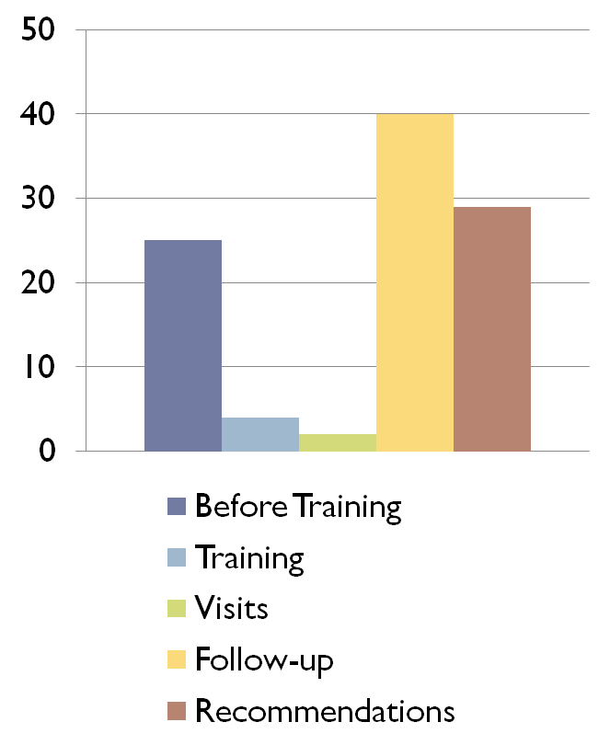
Time in Most Successful
BR&E Visitation Programs
Most successful programs spend 40% (57 hours) on immediate follow-up
The least successful programs spend 22% (11 hours) on this

Slide 17
Resources for Local Leaders
http://www.ag.ndsu.edu/ccv/publications/business-retention-and-expansion-visitation-fundamentals/view
http://www.ag.ndsu.edu/ccv/publications/business-retention-and-expansion-visitation-fundamentals-appendix-a/view
Certified BREI Project Coordinator – YOU!
Universities or higher education (to aggregate and analyze research, write reports etc.)
State/Provincial Economic Development and Community Development agencies

Slide 18

Creative Commons License
This work carries an attribution non-commercial share alike license.
http://creativecommons.org/licenses/by-nc-sa/3.0/
Notes:
Trained and certified instructors by BREI or the Cooperative Extension System are allowed to remix, tweak, and build upon this work non-commercially, as long as they credit the original authors and they must license their new creations under the identical terms. This work can be downloaded and redistributed, but all new work based on this work must carry the same license, so any derivatives will also be non-commercial in nature.

Slide 19
Questions?????

