Slide 1

BR&E Plan & Process

Slide 2
Mission
To foster sustainable economic growth and enhance the quality of life in Stigler, OK by cultivating a vibrant business environment, supporting local entrepreneurs, and leveraging our community’s unique assets.

Slide 3

OBJECTIVES
What is the BR&E process?
Who is involved?
Key Takeaways

Slide 4
BR&E PROCESS
Leadership
Volunteers
Company
Data
Leadership
Action Response
Company

Slide 5
LEADERSHIP TEAM
Total of 10 individuals from the following community partners
  Grow Choctaw
  Stigler Chamber
  PSO
  Cookson Hills
  KTC (Higher Education)
  County Commissioner
  City employee
  Stigler Industrial Trust
  Local Bank representatives (3)
Leadership
Volunteers
Company
Data
Leadership
Action Response
Company

Slide 6
LEADERSHIP TEAM
Duties include:
  BRE initiatives including developing survey,
  Identifying participants,
  Training volunteers,
  Identify the data analysis tool/entity/resource
  Analyze data including identifying possible commonalities,
  Define flag status
  Connect companies to appropriate response team members,
  Marketing of BRE initiative,
  Follow up on survey findings

Slide 7
VOLUNTEER TEAM
Higher Education students/ interns
  Eastern Oklahoma State College
  KTC
  Connors State College
High school student leaders
Stigler Chamber of Commerce
Civic Organizations
Haskell County Leadership Class
Leadership
Volunteers
Company
Data
Leadership
Action Response
Company

Slide 8


VOLUNTEER TEAM
Volunteers will deploy surveys in pairs after required training and data entry from survey results.
Leadership
Volunteers
Company
Data
Leadership
Action Response
Company

Slide 9
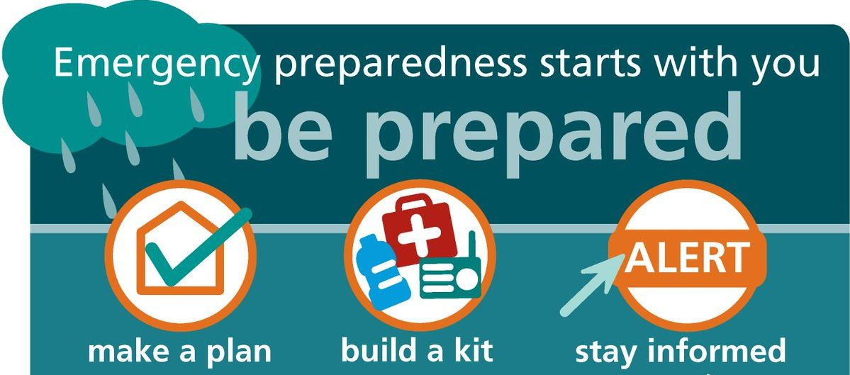
Formulate an Action Plan
Leadership
Volunteers
Company
Data
Leadership
Action Response
Company

Slide 10
ACTION RESPONSE TEAM
Leadership
Volunteers
Company
Data
Leadership
Action Response
Company
Choctaw Small Business
OKSBDC
Utility Companies
Local Government
Higher Education
Stigler Industrial Trust
KEDDO
Stigler Chamber of Commerce
Local Banks

Slide 11
ACTION RESPONSE TEAM
Deployed to appropriate companies based on the needs identified in BRE surveys.
Training
Compliance
Grant Identification
Expertise
Capital
Navigating Red tape (Bureaucracy)
Leadership
Volunteers
Company
Data
Leadership
Action Response
Company

Slide 12
FOLLOW UP
Leadership
Volunteers
Company
Data
Leadership
Action Response
Company

Slide 13

Leadership
Volunteers
Company
Data
Leadership
Action Response
Company

Slide 14
Key Takeaways
The success of this BRE program is only as strong as the relationships you have with your community partners.
Communication
Consistent
Consent
Confidentiality
Continuality

