Slide 1
Business Retention & Expansion
Strategic Planning

Slide 2
Purpose of the Planning Exercise
Action Team agencies and members are identified
The Operations Team collaborates with the Action Team to review research, identify needs, develop implementation plans for short-term issues, and set priorities on longer-term projects
Recommendations are provided to the Management Team and Stakeholders for approval and resource allocation

Slide 3
Action Planning Initiation
What are the key issue(s) that should be addressed?
  Key issues can be gleaned from the response database and the written research report
  Relate these issues to the community profile – how does this issue affect the community’s economic health?
What data from the survey shows this?
  The BR&E process is a data-driven process
  Make sure that any conclusions/recommendations that are drawn can be supported by data

Slide 4
Action Planning Initiation
How are these issues addressed by the Action Team?
  A key component is the knowledge of potential Action Team members and the scope of their missions
  Similar to the flag review session, develop an asset map of local and non-local technical assistance, education, and service providers to facilitate this process. This will provide an outline for assembling the comprehensive Action Team
  Most issues can be broken into more than one part; match each part with the mission of specific Action Team members
  Designate specific Action Team sub-groups to address specific issues

Slide 5
Planning Meeting Needs
In order to develop an effective asset map of potential Action Team members and thorough issue identification, the Operations Team will need the following:
One copy of research report or CRM database output for each person
Slides of key graphs
Community profile
Post-it Note large charts
Report writer(s) and/or a skilled CRM database operator
Facilitator who will keep the process moving
Recorder

Slide 6
Typical Planning Meeting Agenda
Report on visited firm characteristics
Research/survey results are examined to identify issues
Issue components are identified and potential Action Team members are associated
Issue and component prioritization
Operations Team members take ownership for issues
Recruitment/involvement of Action Team members
Planning of future activities

Slide 7
Action Planning Worksheet
What tasks will be carried out? Who on the Action Team is responsible for each task? When will the tasks be completed?
Are there others outside the Action Team that need to be involved?
Detailed suggestions on how to proceed.
What members of the Action Team will be active for a particular issue?

Slide 8
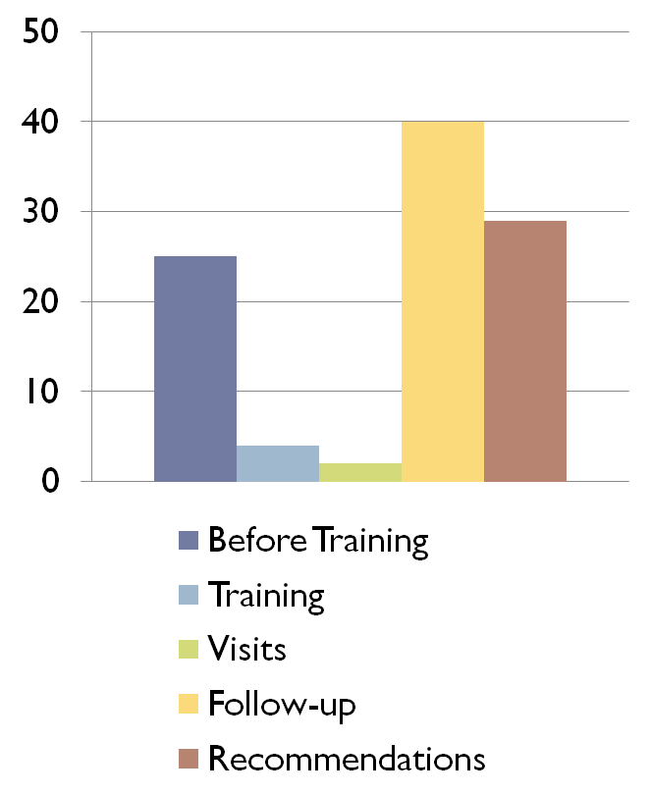
Time Spent in Most Successful
BR&E Visitation Programs
Most successful programs spend 40% of total time spent on immediate followup
The least successful programs only spent 22% of total time on immediate follow-up

Slide 9
Questions

Slide 10
Creative Commons License
This work carries an attribution non-commercial share-alike license.
http://creativecommons.org/licenses/by-nc-sa/3.0/

