Slide 1
Business Retention & Expansion
Community Input, Celebration,
and Program Marketing

Slide 2
Operations Team Sponsored Activities
This supplements the Operations/Action Teams efforts
Community Input/Resources Meeting
Community Commencement/Celebration
Quarterly Meetings (at least with the Task Force/Operations Team and the Action Team on the progress of efforts)
Documentation/evaluation of success in implementation of individual efforts/tasks/strategies

Slide 3
Community Input/Resources Meeting
Purpose of the meeting
  Avoid reinventing the wheel
  Avoid turf battles
  Maximize/leverage the effort of other groups
  Avoid the embarrassment of unknowingly duplicating efforts

Slide 4
Community Input/Resources Meeting
Invite agencies that might be working on your selected priorities
Ask them (ahead of time) to address:
  What are you doing on this project?
  If you are working in this area, are you reaching local firms?
  If not, can we collaborate to reach more of our firms?
This is sometimes done with the full Operations/Action Teams and sometimes with smaller workgroups

Slide 5
Community Celebration (S/C)
In a continuous or segregated approach, there will hopefully be many occasions to celebrate progress
Any type of city/county council meeting, civic clubs, etc., can be used to not only demonstrate the effectiveness of the BR&E Visitation Program, but to get community buy-in and perhaps feedback
Always be prepared for the opportunity to give a 5 or 10 minute “elevator speech” for the program, including factsheets or handouts

Slide 6
Community Commencement (VV/PP)
Celebrates the end of the planning phase and is dedicated to moving aggressively into implementation
Invite everyone directly involved in the program including other local leaders, regional, and national leaders
Aim for 100+ participants

Slide 7
Invite Agency Staff to
Community Commencement Meeting
Include regional and provincial/state staff in the invitation
Provide information so that they can learn about your priority projects
Invite them to speak briefly about how they can help with implementation (send them an advanced copy of the summary so that they are on target)
Invite them to follow-up meetings as well
Encourage their participation in the implementation process

Slide 8
Example Agenda
Program Topic | Person Responsible | Time
Introduction | Project Coordinator | 10 min
Program purpose/history | Task Force/Operations Team Leader | 5 min
Testimonials/accomplishments | Business Owner(s)/Project Coordinator | 10 min
Strategy 1 | Task Force/Operations Team Member A | 10 min
Strategy 2 | Task Force/Operations Team Member B | 10 min
Strategy 3 | Task Force/Operations Team Member C | 10 min
Congratulations | Project Coordinator | 5 min

Slide 9
Publicize the Program Summary
The number and type of firms visited (be sure to get the firms’ explicit permission before names are published)
Include the names and affiliations of the members of the Management, Operations, Action, and Response Teams
Include Stakeholders’ names and affiliations
Community Leaders – Elected, appointed, and others
State/provincial development agencies
Extension service and other technical assistance providers

Slide 10
Reports on Progress
The Operations/Action Teams collaboration should provide regular short updates to other interested parties regarding the progress of implementing the plan
Distribute these updates early and often
Distribute with notices of quarterly meetings and have copies available at the meetings

Slide 11
Plan Implementation
This type of program cannot be accomplished in nine (9) months; it typically takes 2-3 years (minimum)
Other groups will not implement projects developed by the Management and Operations Teams if these teams aren’t involved in the implementation
It is natural for the small implementation groups to shift members
Hold quarterly meetings to monitor progress

Slide 12
Evaluation of Implementation
To what degree do BR&E programs actually implement projects?
What factors are likely to influence the degree of implementation of the priorities set by the Operations/Action Teams?
  Data from 91 BREV programs in four states
  The average program adopted five projects
  What percent of the projects were implemented?

Slide 13
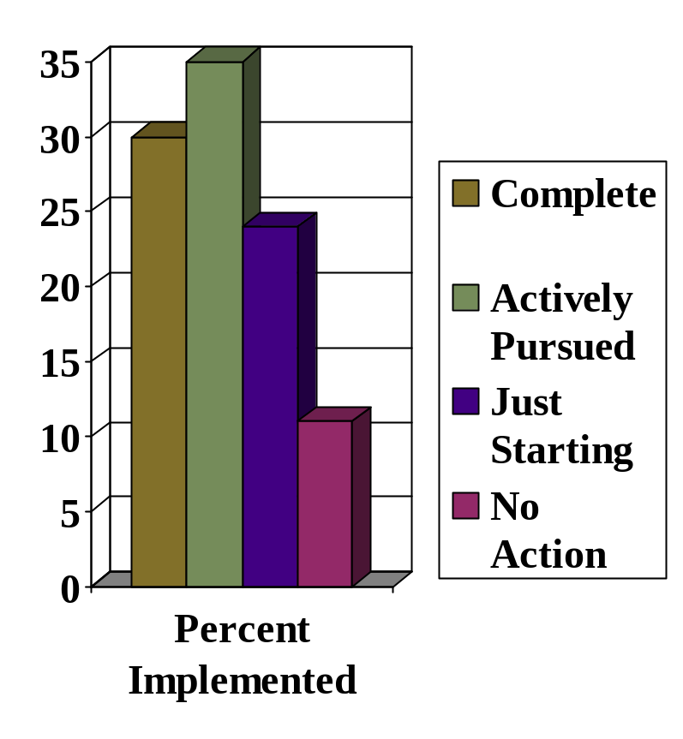
Status of Implementation Efforts
30% of the projects were implemented
35% were being actively pursued
24% were just starting
11% had no action

Slide 14
Factors Increasing Degree of
BR&E Project Implementation
Use proven strategic planning methods … plan for success!
Hold those responsible for implementation accountable
Progress meetings were held after plans were presented
Adequate budget
A person knowledgeable of the process was involved in the program
Time since the completion of the report

Slide 15
Factors Increasing Degree of
BR&E Project Implementation
“How Successful are Business Retention and Expansion Implementation Efforts.” Economic Development Review, 1997.
Programs in this study were performed from 1991-1995
Additional research studies on implementation success are located on the BREI website under the Members Only section

Slide 16
Keep Publicizing Your Program
Market!
Market!
Market!
Market!
Market!
Market!

Slide 17
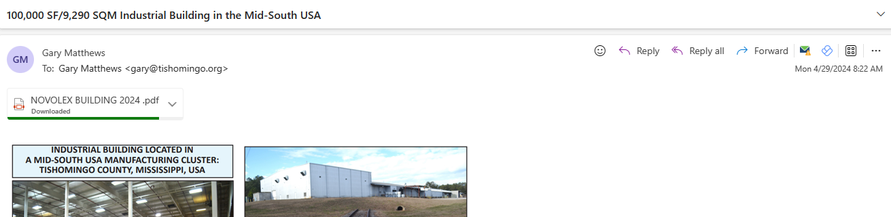
Marketing Your Program
Keep the program in front of your stakeholders and the public through social media
  Linked In, Facebook, Instagram, X
Develop newsletters/announcements of initiatives that the program is undertaking
  Tishomingo EDC (Mississippi)

Slide 18
Marketing Your Program
Podcasts of the progress that the program has achieved
Local/regional newspapers, public service announcements
Local access radio and television
Seek out speaking engagements with local civic clubs
National/international publications
  Site Selection - https://siteselection.com/digitaledition/

Slide 19
Questions

Slide 20
Creative Commons License
This work carries an attribution non-commercial share-alike license.
http://creativecommons.org/licenses/by-nc-sa/3.0/

