Slide 1

Business Retention and Expansion Plan
Carbon County Economic Development Corporation's strategy for supporting existing businesses and fostering local growth.
RZ
Mission: To be the trusted resource for driving Economic Development in Carbon County

Slide 2
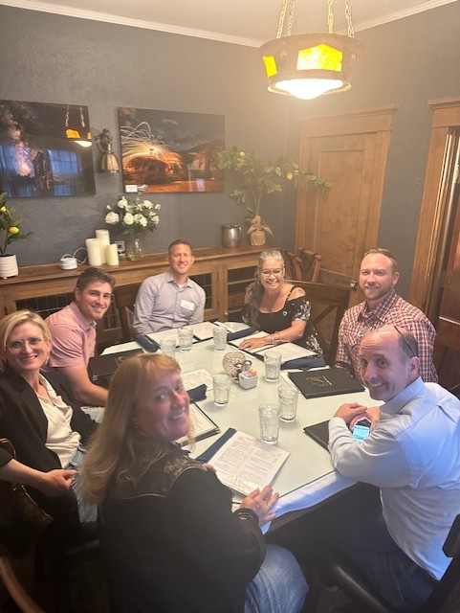
Leadership Team
Program Leadership
EDC Representatives
Yvonne Johnson, Certified BRE Coordinator
Jeremy Slack, County EDC Chair
Tom Sarvey, City Manager
Sandra Dent, HF Sinclair Board Member/Secretary
Key Partners
Jennifer Moore, Higher Education Center
Copper France, CCEDC Media Rep./Bank of Commerce CEO

Slide 3
BRE Task Force Composition
Business Leaders
Government Officials
Community Partners
Copper France, BOC Bank CEO
Jacquelin Wells, Mayor
Jennifer Moore, Education
Amanda Moore, Business Owner
Gwynn Bartlett, CC Commissioner
Dr. Stephanie Chiu, Medical
Amy Bach, Attorney
Sue Jones, CC Commissioner
Damien Cesko, Civic Leader
Dr. Travis Moore, Chairman CCC

Slide 4
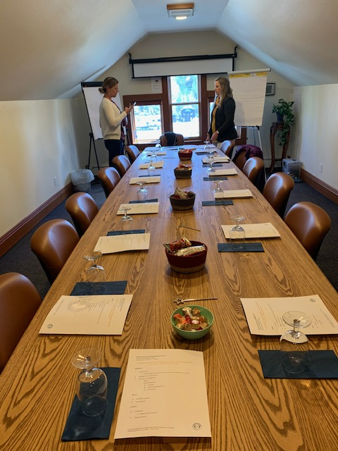




Task Force Organization Meeting
Purpose & Roles
Establish survey goals and task force responsibilities
Confidentiality Protocol
Emphasize listening, no arguing, strict confidentiality
Survey Targets
Determine realistic first-year business count
Appointment Process
Yvonne sets appointments, attends all meetings

Slide 5

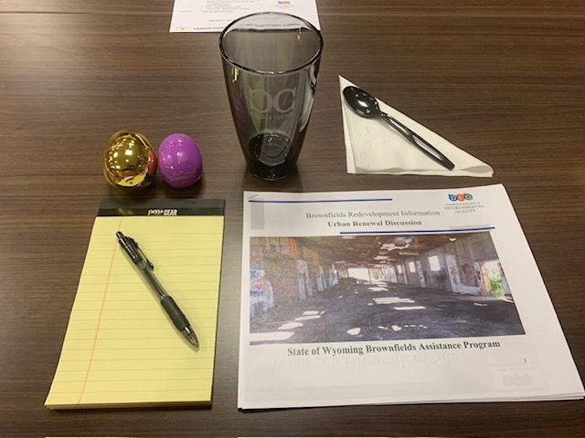



Firm Visitor Training
Survey Review
Examine questions developed by Yvonne and CCEDC
Practice Interviews
Role-play with CCEDC Board members
Finalize Targets
Confirm company list and visitor assignments
Set Deadlines
Establish completion date and reporting schedule

Slide 6






Red Flag Protocol
Immediate Response
Yvonne or relevant task force member addresses urgent concerns
Data Management
Survey results entered in CRM with action steps
Confidentiality
All concerns handled with strict privacy protocols

Slide 7
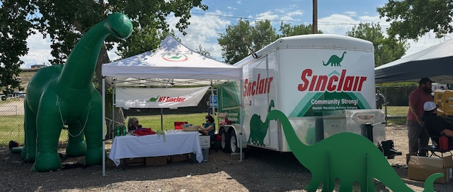
Results Meeting &
Next Steps
Data Collection
Results Presentation
All surveys submitted to Yvonne for tabulation
Findings shared with confidential handling of red flags
Ongoing Communication
Action Planning
Quarterly updates to Board and Task Force
Establish priorities and next steps for CCEDC Board

